Slide 1
Week 7-Lec 3
IP protocol and IP addressing

Slide 2

IP addressing: introduction
223.1.1.1
IP address: 32-bit identifier associated with each host or router interface
interface: connection between host/router and physical link
router’s typically have multiple interfaces
host typically has one or two interfaces (e.g., wired Ethernet, wireless 802.11)
223.1.2.1
223.1.1.2
223.1.1.4
223.1.2.9
223.1.1.3
223.1.3.27
223.1.2.2
223.1.3.1
223.1.3.2
dotted-decimal IP address notation:
223.1.1.1 = 11011111 00000001 00000001 00000001
223
1
1
1

Slide 3
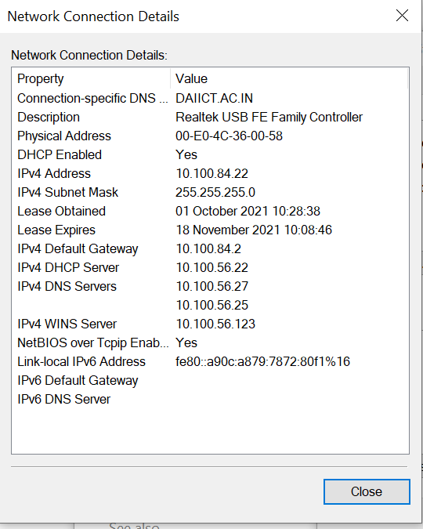
What is an IP address?

Slide 4
Example Of Dotted Decimal
Notation
A 32-bit number in binary
10000000 00001010 00000010 00000011
The same
notation
32-bit
number expressed in
dotted
decimal
128 . 10 . 2 . 3
Internetworking With TCP/IP vol 1
-- Part 4
22
2005

Slide 5
What comprises an IP address?
Break the bunch of bits into 4 parts (8 bits each)
11000000. 10101000.01111011.10000100
Subnet Mask: local or remote network?
11000000.10101000.01111011.10000100
11111111. 11111111. 11111111. 00000000
-------------------------------------------------------
11000000. 10101000. 01111011.00000000
------------------------------------------------------
Network part: 192.168.123.0 (all 1s in the mask)
Host part:0.0.0.132 (all 0s in the mask)
Set of decimal numbers
192.168.123.132
What can we understand from this?
NOTHING
How do routers interpret this decimal number?
Set of binary digits
1100000010101000111101110000100
Can we make sense of it now?

Slide 6
IP addresses
How are addresses configured?
Manually
DHCP (server)
What are the requirements for assigning IP addresses to machines?
# Hosts
# Networks
Who gives a block of addresses to organizations?
ICANN: Internet Corporation for Assigned
Names and Numbers http://www.icann.org/
allocates addresses
manages DNS
assigns domain names, resolves disputes

Slide 7
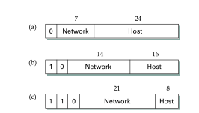
Classes in IP addresses
Number of networks
Number of hosts
Class
Lowest Address
Highest Address
A
B
C
D
E
1.0.0.0
128.1.0.0
192.0.1.0
224.0.0.0
240.0.0.0
126.0.0.0
191.255.0.0
223.255.255.0
239.255.255.255
255.255.255.254

Slide 8
Subnets
223.1.1.1
What’s a subnet ?
device interfaces that can physically reach each other without passing through an intervening router
223.1.2.1
223.1.1.2
223.1.1.4
223.1.2.9
223.1.1.3
223.1.3.27
223.1.2.2
IP addresses have structure:
subnet part: devices in same subnet have common high order bits
host part: remaining low order bits
223.1.3.1
223.1.3.2
network consisting of 3 subnets

Slide 9
Subnets
subnet 223.1.1.0/24
223.1.1.1
subnet 223.1.2.0/24
Recipe for defining subnets:
detach each interface from its host or router, creating “islands” of isolated networks
each isolated network is called a subnet
223.1.2.1
223.1.1.2
223.1.1.4
223.1.2.9
223.1.1.3
223.1.3.27
223.1.2.2
subnet
223.1.3.0/24
223.1.3.1
223.1.3.2
subnet mask: /24
(high-order 24 bits: subnet part of IP address)

Slide 10
Subnets
223.1.1.2
subnet 223.1.1/24
where are the subnets?
what are the /24 subnet addresses?
223.1.1.1
223.1.1.4
223.1.1.3
223.1.9.2
223.1.7.0
subnet 223.1.7/24
subnet 223.1.9/24
223.1.9.1
223.1.7.1
223.1.8.1
223.1.8.0
subnet 223.1.2/24
223.1.2.6
subnet 223.1.8/24
223.1.3.27
subnet 223.1.3/24
223.1.2.1
223.1.2.2
223.1.3.1
223.1.3.2

Slide 11
IP Datagram format
32 bits
IP protocol version number
head.
len
type of
service
total datagram
length (bytes)
ver
length
header length(bytes)
“type” of service:
diffserv (0:5)
ECN (6:7)
flgs
fragment
offset
fragmentation/
reassembly
16-bit identifier
time to
live
upper
layer
header
checksum
header checksum
TTL: remaining max hops
(decremented at each router)
source IP address
32-bit source IP address
destination IP address
Maximum length: 64K bytes
Typically: 1500 bytes or less
upper layer protocol (e.g., TCP or UDP)
32-bit destination IP address
overhead
options (if any)
e.g., timestamp, record route taken
20 bytes of TCP
20 bytes of IP
= 40 bytes + app layer overhead for TCP+IP
payload data
(variable length,
typically a TCP
or UDP segment)

Slide 12
IP fragmentation, reassembly
network links have MTU (max.transfer size) - largest possible link-level frame
different link types, different MTUs
large IP datagram divided (“fragmented”) within net
one datagram becomes several datagrams
“reassembled” only at final destination
IP header bits used to identify, order related fragments
…
fragmentation:
in: one large datagram
out: 3 smaller datagrams
reassembly
…

Slide 14
IP fragmentation, reassembly
length
=4000
ID
=x
fragflag
=0
offset
=0
example:
4000 byte datagram
MTU = 1500 bytes
one large datagram becomes
several smaller datagrams
1480 bytes in data field
length
=1500
ID
=x
fragflag
=1
offset
=0
offset =
1480/8
length
=1500
ID
=x
fragflag
=1
offset
=185
length
=1040
ID
=x
fragflag
=0
offset
=370

